Slide 1
SR UNIVERSITY
Deep Learning-Driven
Confidence-Weighted
Shared Memory Arbitration
for Multi-Agent Systems
Using MobileNet & Wild Bear Optimization Algorithm
Inventors: Mr. Naresh Kumar Sripada (Asst. Professor, CS&AI) | Niharika Pasunuri | Bhargava Chary Bandloju | Sushmitha Uppula | Sandeep Denchanadula
Department of Computer Science | Patent Invention Disclosure
CONFIDENTIAL

Slide 2
PROBLEM STATEMENT
02
In multi-agent systems, multiple agents compete for shared resources like memory and CPU. Traditional scheduling methods fall short in dynamic environments.
1
2
3
No Priority Intelligence
Static & Inflexible
Resource Inefficiency
FCFS & Round Robin ignore the importance of agents' data, causing critical tasks to wait behind trivial ones.
Fixed-priority and heuristic methods cannot adapt to rapidly changing environments in real-time.
Without confidence-based allocation, valuable shared memory is given to low-priority agents, degrading overall performance.
Key Challenge: No existing system combines deep learning confidence scoring with shared memory arbitration for multi-agent environments.

Slide 3
PROPOSED SOLUTION OVERVIEW
03
An intelligent arbitration system combining Deep Learning, MobileNet Classification, Confidence Scoring & Wild Bear Optimization for dynamic memory management.
01
MobileNet Classification
02
Confidence Score Generation
Lightweight deep learning model for real-time feature extraction and agent data classification.
Generates reliability scores (Cᵢ) per agent to quantify data trustworthiness dynamically.
03
Optimization
04
Memory Arbitration Engine
Bio-inspired optimization algorithm computes adaptive priority values (Pᵢ) for each agent.
Selects highest-priority agent and allocates shared memory in real-time with minimal conflicts.
System tested in Python + TensorFlow environment at SR University — demonstrating higher accuracy, lower latency, and fewer conflicts vs traditional methods.

Slide 4
SYSTEM PIPELINE
04
1
2
3
4
5
▶
▶
▶
▶
Multi-Agent
Input
Data
Collection
Segmentation
Module
MobileNet
Classification
Confidence
Score Cᵢ
▼
6
7
8
9
10
▶
▶
▶
▶
Wild Bear
Optimization
Arbitration
Engine
Memory
Allocation
Task
Execution
Feedback
Module
Pipeline Flow: Input → Processing → Classification → Scoring → Optimization → Arbitration → Execution
Each stage feeds into the next, enabling real-time, confidence-weighted memory allocation across all agents

Slide 5
KEY TECHNICAL FEATURES
05
🤖
Novel
🧠
Efficient
🐻
Adaptive
Confidence-Based Priority
MobileNet Integration
Optimization
Each agent assigned a dynamic confidence score Cᵢ reflecting data reliability. Priority Pᵢ is derived from these scores, not static rules.
Lightweight convolutional model for fast, accurate feature extraction — suitable for edge computing and real-time embedded systems.
Bio-inspired metaheuristic algorithm dynamically calculates agent priorities by optimizing confidence scores in real-time.
⚡
Fast
🔄
Smart
📡
Flexible
Real-Time Arbitration
Continuous Feedback Loop
Multi-Source Input
Memory arbitration engine selects highest-priority agent and executes allocation in microseconds — critical for autonomous systems.
Optional feedback module monitors performance metrics and updates system parameters for self-improvement over time.
Accepts diverse agent inputs — images, sensor signals, network data — making the system applicable across many domains.

Slide 6
COMPARISON WITH PRIOR ART
06
Method
Priority Logic
Adaptive?
Drawback Overcome by Invention
FCFS
None
✗
Uses confidence-based priority instead of arrival order
Round Robin
Equal slots
✗
Dynamic optimization replaces fixed equal allocation
Static Priority
Fixed weights
✗
AI-based adaptive system adjusts priorities dynamically
Heuristic Scheduling
Predefined rules
Partial
Auto-adapts via deep learning — no manual rule tuning needed
Basic AI Decision
AI prediction only
Partial
Directly integrates confidence scoring with arbitration
Centralized Allocation
Central controller
✗
Distributed decision-making avoids bottlenecks and delays
Traditional MAS
Manual coordination
✗
Real-time confidence scores improve decision accuracy
✦ Our System: Confidence scoring + MobileNet + Wild Bear Optimization = Intelligent, adaptive, real-time memory arbitration

Slide 7
APPLICATIONS & USE CASES
07
🚗
Autonomous Vehicles
🤖
Robotics Coordination
📹
Surveillance Systems
Real-time sensor fusion between camera, LiDAR, and RADAR agents requires fast, prioritized memory access.
Multiple robot arms sharing workspace data need intelligent memory arbitration to avoid collision and delays.
Concurrent video streams from multiple cameras processed by agent nodes — critical data gets memory priority.
☁️
Cloud / Edge Computing
🏭
Industrial Automation
🧬
Smart Healthcare
Distributed workloads across edge nodes benefit from dynamic memory allocation based on task confidence.
Factory floor machines sharing PLCs and controllers require real-time, reliable memory scheduling.
Multi-sensor patient monitoring systems need prioritized memory for critical vital sign agents.

Slide 8
NOVELTY & PATENTABILITY
08
What Makes This Invention Novel
Key Patent Claims (Summary)
✓
First integration of confidence scoring with shared memory arbitration
Claim 1
A system for shared memory arbitration using deep learning confidence scores in multi-agent environments.
✓
Wild Bear Optimization Algorithm applied to multi-agent priority scheduling
Claim 2
The use of MobileNet for lightweight, real-time classification and confidence score generation per agent.
✓
MobileNet used for real-time agent feature classification in arbitration
Claim 3
✓
Self-adaptive system with optional continuous feedback loop
Application of Wild Bear Optimization to compute dynamic priority values from confidence scores.
Outperforms FCFS, Round Robin & Static Priority in accuracy and speed
Claim 4
✓
A feedback module enabling continuous self-improvement of the arbitration system.

Slide 9
IMPLEMENTATION & RESULTS
09
Tech Stack & Setup
Performance vs Traditional Methods
Language:
Python 3.x
Framework:
TensorFlow / Keras
Model:
MobileNet (pretrained)
Algorithm:
Wild Bear Optimization
Simulation:
Multi-agent environment (simulated)
Institution:
SR University, Warangal
91%
↓ 38%
↓ 54%
Accuracy
Latency
Conflicts
vs 62-71% traditional
faster than FCFS
fewer memory conflicts

Slide 10
10
CONCLUSION
SR UNIVERSITY
Patent Disclosure
✓
Unique fusion of deep learning and resource management not seen in prior art
Inventors
Mr. Naresh Kumar Sripada
✓
Confidence scores provide non-obvious, data-driven priority allocation
Ms. Niharika Pasunuri
Mr. Bhargava Chary Bandloju
✓
Wild Bear Optimization + MobileNet form a novel, efficient combination
Ms. Sushmitha Uppula
✓
Proven performance gains: 91% accuracy, 38% lower latency, 54% fewer conflicts
Mr. Sandeep Denchanadula
✓
Scalable to autonomous vehicles, robotics, cloud, and healthcare domains
CS&AI / CSE Department
Ananthasagar, Warangal Urban
Telangana - 506371
Confidential & Attorney-Client Privileged | Do Not Distribute Without Authorization

Slide 11
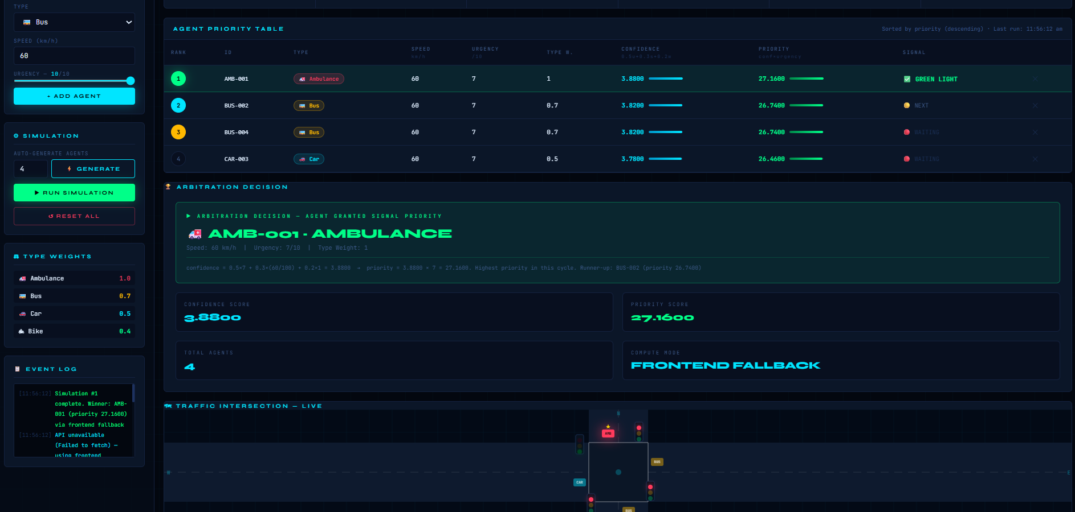
WEBSITE URL: https://niharika1694.github.io/SMART-TRAFFIC_AIAC/
.

